Slide 1
Capstone Project
Synopsis Presentation
Decentralized Data and Resource-Provisioning System with End-Point Security
Team Members: Yash Burshe K007 Ridhima Mishra K035 Arushi Rai K047 B. Tech Computer Science Engineering (Specialization: Cybersecurity) 2023-24 | Faculty Mentor: Dr. Pintu Shah

Slide 2
Industry Mentor
Godwin Jathanna
ISSM – TATA Advanced Systems Ltd. Mumbai

Slide 3
Introduction
Current data management practices – manual allotment of data access and permissions introduces significant vulnerabilities
Makes the system prone to single points of failure and susceptible to various risks.
human errors,
disgruntled employees,
“whistle-blowers”, etc.
with unauthorized access pose serious threats to data security and integrity.
These factors can lead to:
data breaches
leakage of sensitive information
compromised data privacy
resulting in severe consequences for organizations.
Notes:
In the current data management practices still being implemented at leading organizations that process a plethora of data across thousands of employees, vendors, and customers, the manual allotment of data access and permissions introduces significant vulnerabilities, making the system prone to single points of failure and susceptible to various risks. For instance, human errors, disgruntled employees, “whistle-blowers”, etc. with unauthorized access pose serious threats to data security and integrity. These factors can lead to data breaches, leakage of sensitive information, and compromised data privacy, resulting in severe consequences for organizations.

Slide 4


Slide 5
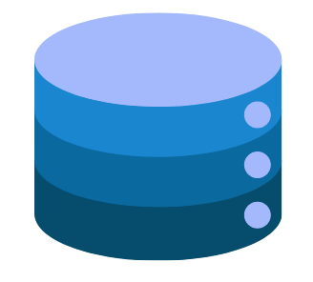
IT Exec

Slide 6
Our Project
A decentralized file and resource storage system, employing blockchain technology.
Replacing the manual allocation process with a consensus-based system, controlled and maintained by smart contracts.
Uses Proof of Authority: based on position in the company hierarchy
Smart contracts based on company policies, guidelines, regulations
0-trust architecture
A more secure, transparent, and tamper-resistant data management solution
Smart contracts: self-executing protocols
Eliminates the need for intermediaries
Resistant to collusion and manipulation
Increases immunity to social engineering
Enhances auditability and traceability
More prompt notifications in case of suspicious activity
Notes:
To mitigate these risks and enhance data security, our project proposes a decentralized file storage system, employing blockchain technology to revolutionise data access control. We want to replace the manual allocation process with a consensus-based system, controlled and maintained by smart contracts. The goal is to create a more secure, transparent, and tamper-resistant data management solution.
Our proposed system utilises a Proof of Authority mechanism, and the smart contracts are pre-defined based on company policies, laws, guidelines, and regulations. This system ensures that only authorized entities are granted access to specific data based on their roles within the organization hierarchy. Each user's reputation is stored on the blockchain in line with that user’s position in the organization hierarchy, establishing a trust-based approach for data access and permission granting.
By leveraging blockchain's decentralized nature and immutability, the system minimizes the risks associated with centralized authority and reduces the chances of data breaches due to human factors. The smart contracts act as self-executing protocols, eliminating the need for intermediaries, and ensuring that access control decisions are automated, transparent, and resistant to manipulation.
The proposed system brings greater accountability and transparency, as all data access and permission changes are recorded on the blockchain, making it auditable and traceable. Any attempt to tamper with the data or modify access permissions without proper authorization will be immediately detected and flagged, ensuring data integrity and mitigating insider threats.

Slide 7
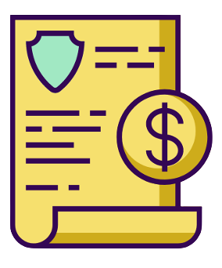
Added to the private Blockchain n/w
Quicker, policy and regulatory-compliant
Tamper-resistant logging and execution

Slide 8
Key Features
Smart contracts: self-executing protocols, eliminates the need for intermediaries
Resistant to collusion and manipulation
Increases immunity to social engineering
Enhances auditability and traceability
Ensures policy and regulatory compliance
More prompt notifications in case of suspicious activity
Scalability and performance
Future scope in IoT-related data sharing

Slide 9
Literature Survey
(2020). BDSS-FA: A Blockchain-Based Data Security Sharing Platform With Fine-Grained Access Control. IEEE Access
…The system framework includes Key Generation Center (KGC), Data Owner (DO), P2P based data distribution platform, IPFS Cluster, Fabric Blockchain and Data Consumer (DC)…
(2021). Blockchain-Enabled Data Sharing in Supply Chains: Model, Operationalization, and Tutorial. Production and Operations Management
The paper provides a step-by-step guide for setting up a blockchain-enabled data-sharing marketplace using Hashgraph
(2020). A Medical Data Sharing Scheme Based on Attribute Cryptosystem and Blockchain Technology. IEEE Access
The proposed scheme combines attribute-based encryption (ABE) and attribute-based signature (ABS), which achieves the sharing of medical data in many-to-many communications.

Slide 10

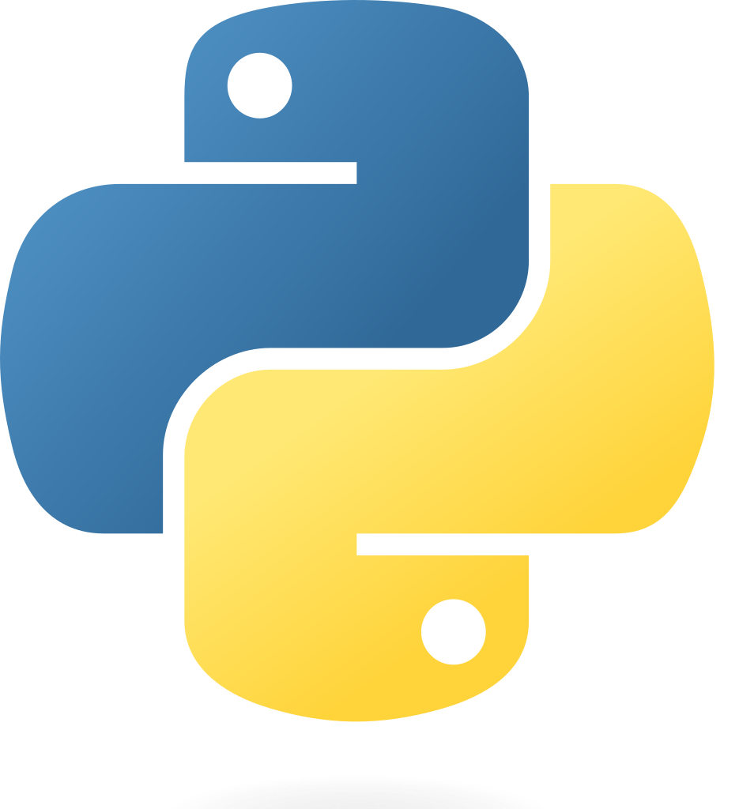
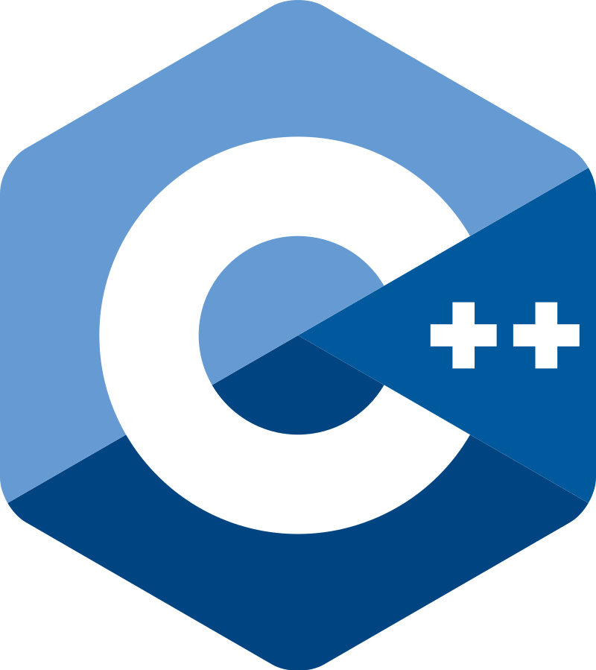

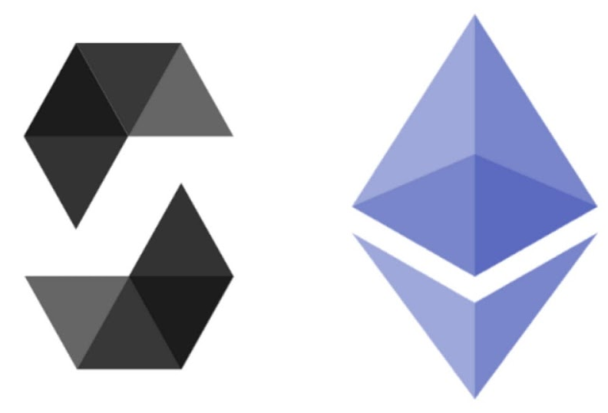
Technology Stacks

Slide 11
Objectives & Scope
Blockchain-controlled Data Sharing
Multi-user Access & Role-based Authentication
Persistent Metadata Management
End-point Security Measures
Encryption with Integrity Controls
Fine-grained File Sharing
Notifications for policy non-compliance or violations
Notes:
The main objectives of this project are to develop a secure and efficient blockchain and smart contracts-controlled data sharing platform with multi-user access and role-based authentication. The platform aims to address the vulnerabilities in current data management practices by providing fine-grained access control, persistent metadata management, and robust end-point security measures.
Blockchain-Controlled Data Sharing:
Our primary goal is to create a decentralized data sharing platform leveraging blockchain technology. This will ensure a distributed and tamper-resistant network, eliminating single points of failure and unauthorized access. We will utilize smart contracts to automate data sharing and resource-provisioning processes, to promote transparency and accountability.
Multi-User Access and Role-Based Authentication:
This project will implement a comprehensive user authentication system with role-based access control (RBAC). Different user roles within the organization hierarchy will be granted specific access permissions, enhancing data security and minimizing the risk of unauthorized data exposure. The roles of individuals in the company will also be used to facilitate a Proof of Authority consensus mechanism.
Persistent Metadata Management:
Our platform will incorporate a robust metadata management system to facilitate policy-compliant data classification and access control. Metadata will store vital information related to data ownership, access permissions, update records, and usage policies, and much more, to ensure compliance with company policies and regulatory requirements.
End-Point Security Measures:
To enhance user interactions' security, our project will implement end-point security measures. Secure communication protocols will be employed to safeguard data transmission between clients and the platform.
Encryption with Integrity Controls:
To safeguard multi-user data, we will use encryption with integrity controls. Advanced cryptographic techniques will be used to ensure data confidentiality and integrity, protecting sensitive information from unauthorized access and tampering.
Fine-Grained File Sharing:
The project will analyze and implement access control mechanisms to enable fine-grained file sharing between various components of the organization hierarchy. Attribute-based access control (ABAC) will be explored to handle complex access control policies efficiently.
Notifications for Policy Non-Compliance or Violations:
An essential aspect of the platform will be the incorporation of a notification system to alert relevant users and administrators in case of policy non-compliance or access control violations. Real-time notifications will be sent through emails, messages, and in-app alerts to promptly address any security breaches or policy violations.

